Slide 1
Localization of prostate cancer using multiparametric MRI based on semisupervised technique
Under the guidance of
Mr. U. A. Patil sir
My self- Madnaik Pooja B.
Roll no-14MEETRX12

Slide 2
Contents-
Introduction
Relevance
Problem statement
Objective
Block diagram
Performance parameter
Conclusion
References

Slide 3
Introduction
Prostate cancer is a major health problem .
MRI provides the best description of the contours of the prostate as well as its internal anatomy.
Random walker algorithm is a seeded segmentation technique .

Slide 4
Relevance
Recent cancer studies have determined that 217 730 men were diagnosed, and 32 050 died because of prostate cancer in the U.S.in 2010.
Cancer may be missed due to limited number of biopsy samples and low resolution of TRUS.
Multispectral MRI provides anotomical and fuctional information of body.

Slide 5
Problem statement
Localizing prostate cancer using multiparametric magnetic resonance images based on semisupervised technique adapting random walker algorithm for seed segmentation.

Slide 6
Objective-
To collect the multiparametric MRI images from different hospital.
To preprocess the multiparametric magnetic resonance images using median filter, normalization and anisotropic filtering.
To implement laplacian support vector machine to initialize the seed location .
To identify random walker seeds using morphological operation.
To implement random walker algorithm for seed segmentation.

Slide 7

Block Diagram
Block diagram for preprocessing-
Preprocessing involve three main steps as follow.
1. Median Filter
2.Normalization
3.Anisotropic Filter

Slide 8
Median Filter
Nonlinear method
It reduces noise.
How median filter work
It replace the center value in the window with median of all the pixel values in the window.

Slide 9
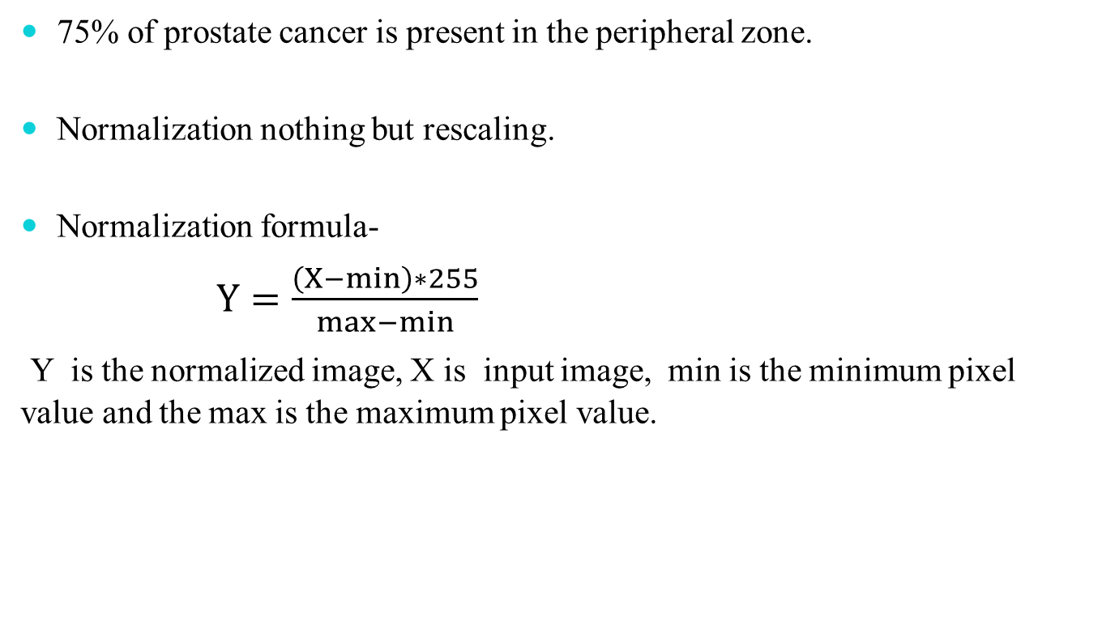
Normalization
75% of prostate cancer is present in the peripheral zone.
Normalization nothing but rescaling.
Normalization formula-
$Y=\frac{\left(X−min\right)∗255}{max−min}$
Y is the normalized image, X is input image, min is the minimum pixel value and the max is the maximum pixel value.

Slide 10
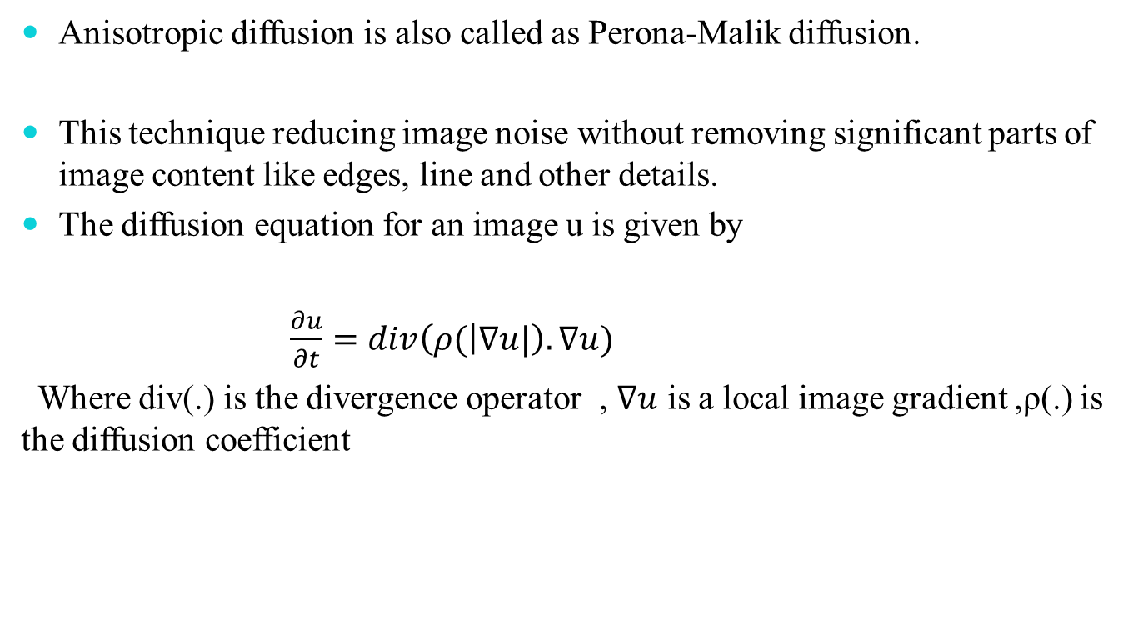
Anisotropic filtering
Anisotropic diffusion is also called as Perona-Malik diffusion.
This technique reducing image noise without removing significant parts of image content like edges, line and other details.
The diffusion equation for an image u is given by
$\frac{∂u}{∂t}=div\left(ρ( | ∇u|\right).∇u)$
Where div(.) is the divergence operator , $∇u$ is a local image gradient ,ρ(.) is the diffusion coefficient

Slide 11
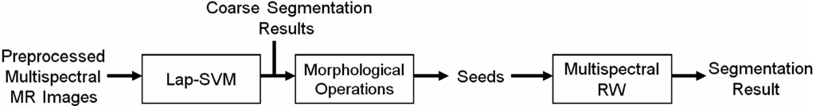
Block diagram for segmentation

Slide 12
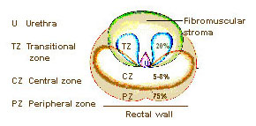
Prostate zone

Slide 13



Performance parameter
Accuracy-
Sensitivity-
Specificity-

Slide 14
Conclusion
Automatically localizing prostate cancer with multiparametric MR images using a new approach of semisupervised segmentation.
RW method with automated seed initialization is able to produce improved segmentation results by assigning more weights to the images with more discriminative power.

Slide 15
References
Yusuf Artan and Imam Samil Yetik, Senior Member, IEEE, “Prostate Cancer Localization Using Multiparametric MRI based o SemisupervisedTechniques With Automated Seed Initialization” IEEE trans. on information technology in biomedicine, vol.16,no.6, November 2012
Robert Sheng Xu, Student Member, IEEE, Oleg Michailovich, Member, IEEE, and Magdy Salama, Fellow, IEEE, “Information tracking approach to segmentation of ultrasound imagery of the prostate.” IEEE trans. on ultrasound, ferroelectrics, and frequency control,vol 57, no. 8,August 2010.
Jennifer S. Huber, Member, IEEE, Qiyu. Peng, Member, IEEE, William W. Moses, Fellow, IEEE, Bryan W. Reutter, Senior Member, IEEE, Jean Pouliot, and I. Chow Hsu, “Development of a PET Transrectal Ultrasound Prostate Imaging System.” IEEE trans. on nuclear science , vol.58, no.3, June 2011.
Y. Artan,M.A. Haider, D. Langer, T.H. van der Kwast, A. Evans, Y. Yang, M.Wernick, and I. S. Yetik, “Prostate cancer localization with multispectral MRI using cost-sensitive support vector machines and conditional random fields,” IEEE Trans. Image Process., vol. 19, no. 9, pp. 2444– 2455, Oct. 2010.
L. Grady, “Random walks for image segmentation,” IEEE Trans. Pattern Anal. Mach. Intell., vol. 28, no. 11, pp. 1–17, Nov. 2006.

